Slide 1
What’s New for 2019 Tax Season

Slide 2
Federal Tax Law Changes
2019 1040 and associated Schedules changed
2019 1040 rearranged/renumbered
Includes 2018 Sch 6 Third Party Designee
2018 Sch 1 – 6 condensed to three 2019 schedules
2019 Sch 1 Additional Income and Adjustments to Income
Date of original divorce added for alimony paid
2019 Sch 2 Additional Taxes
2018 Schedules 2 Taxes + Sch 4 Other Taxes
2019 Sch 3 Additional Credits and Payment
2018 Sch 3 Nonrefundable Credits + Sch 5 Other Payments and Refundable Credits

Slide 3
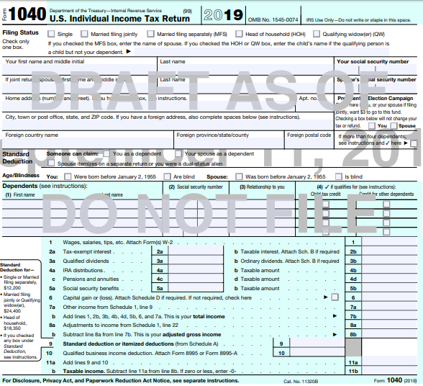
1040 Front Page
“Full-year health coverage or exempt” box eliminated
Standard deduction
questions
IRA and Pension lines split
Capital Gains line moved from Sch 1
Income section on front

Slide 4
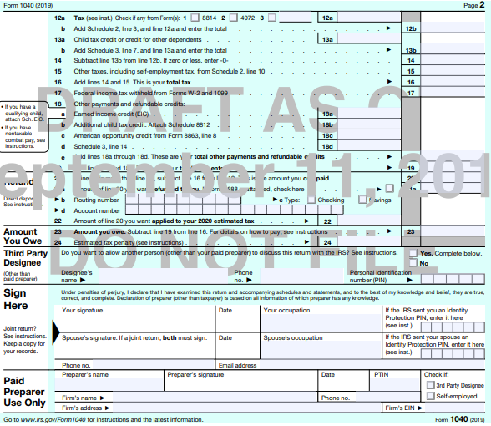
1040 Back Page
Draft IRS forms:
https://apps.irs.gov/app/picklist/
list/draftTaxForms.html
Third Party Designee
Section moved from
Sch 6
Signature section moved from front page

Slide 5
Federal Tax Law Changes cont’d
1040-SR form added for seniors
To use:
Age 65 or older
Not necessarily retired
May use either standard deduction or itemized
Bigger font and prominently displayed chart to calculate standard deduction
TaxSlayer will not be adding this form to any of their assigned print sets; available if we want to include in a custom print set

Slide 6
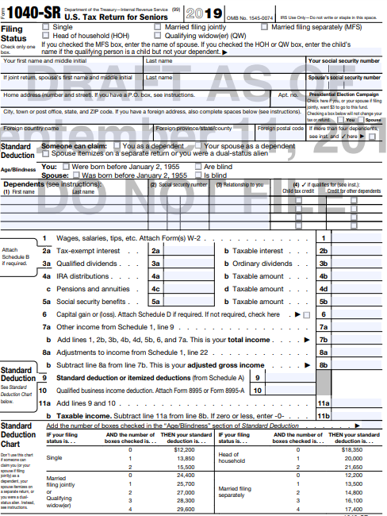
1040-SR Front Page
Standard deduction
questions
Standard Deduction
chart

Slide 7
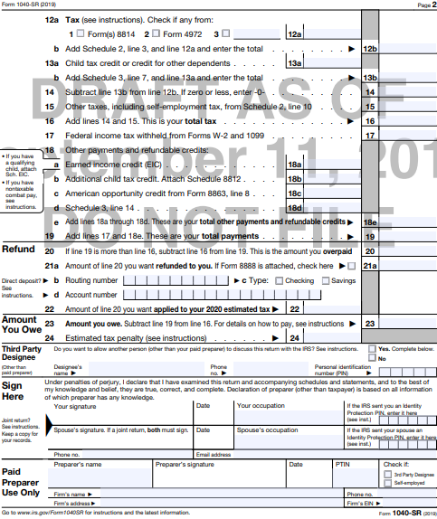
1040-SR Back Page cont’d

Slide 8
Federal Tax Law Changes cont’d
New IRS forms
Form 8995 Qualified Business Income Deduction Simplified Computation
Form 8995-A Qualified Business Income Deduction
Obsolete IRS forms
Sch C-EZ for Self-Employment income
Form 2555-EZ for Foreign Earned Income

Slide 9
Federal Tax Law Changes cont’d
Same 7 tax rates but wider tax brackets
Same 3 capital gains tax rates but income thresholds go up
Standard deductions increase
MFJ or QW - $24,400 (+ $400)
Single or MFS - $12,200 (+ $200)
HOH $18,350 - (+ $350)
Additional standard deduction for 65 or older or blind $1,300 per qualifying spouse for MFJ, $1,650 for unmarried (+ $50)
For individual who can be claimed as a dependent on another’s return, standard deduction cannot exceed the greater of $1,100 or sum of $350 + individual’s earned income (not to exceed regular standard deduction)

Slide 10
Federal Tax Law Changes cont’d
Alimony received under post-2018 divorce agreements is no longer reported as income; alimony paid is no longer deducted as adjustment
Pre-2019 divorce agreements follow old rules – alimony received is income; alimony paid is an adjustment
Older divorce pacts modified in 2019 or later can specify to follow new rules if both parties concur
NJ will continue to follow alimony rules for pre-2019 divorces
Do not yet know how TaxSlayer will handle this difference

Slide 11
Federal Tax Law Changes cont’d
Deductions for medical expenses
Thresholds for deducting medical expenses on Sch A rises to 10% of AGI
10% also applies to Early Withdrawal exception for medical expenses on Form 5329
Limits on deducting long-term-care premiums are higher
Annual cap on deductible HSA contributions rises to $3,500 (+$50) for self-only coverage/$7,000 (up $100) for family coverage

Slide 12
Federal Tax Law Changes cont’d
ACA changes
Shared Responsibility Payment (SRP) reduced to $0 if no health insurance
No need for exemptions, so Form 8965 goes away
Income limits to qualify for Premium Tax Credit (PTC) go up
Standard mileage rates
Business miles – 58 cents per mile (+$.035)
Medical miles – 20 cents per mile (+$.02)
Charitable miles – 14 cents per mile (no change)

Slide 13
Federal Tax Law Changes cont’d
Gross income limitation to claim a Qualifying Relative increases to $4,200 (+$50)
Maximum 401(k)/403(b)/457 plan contributions rise to $19,000 (+$500)
$6,000 extra for 50 or older
Maximum traditional/Roth IRA contributions rise to $6,000 (+ $500)
$1,000 extra for 50 or older
Phase out and threshold limits increased
Retirement Savings Credit, Lifetime Learning Credit, Student Loan Interest Deduction increased
American Opportunity Credit phase out limits remain the same as 2018

Slide 14
Federal Tax Law Changes cont’d
EIC amounts increase
Maximum Earned Income Credit (EIC) increases to $6,557 (+ $126)
Eligibility income limits increase
Investment income cannot be more than $3,600 (+$100)
ITINs expire – must take action to renew
ITINs not used in the last 3 consecutive tax years
ITINS with middle digits of 83, 84, 85, 86, 87
Consent forms in Intake/Interview booklet only signed if approval granted

Slide 15
Federal Tax Law Changes cont’d
How to handle NJ income tax refunds or property tax recoveries if Sch A state taxes were limited by $10,000 cap in year deducted
Determine amount of itemized deductions that taxpayer (TP) would have deducted in prior year had TP paid only proper amount of tax
Compare to total itemized deductions actually taken or standard deduction that could have been taken
Include difference as Other Income on current year return if taxpayer received a tax benefit

Slide 16
Situation #1
Situation #1:
2018 NJ income taxes $4,000
2018 Property taxes $5,000
2018 Total state taxes claimed $9,000
2018 Other itemized deductions $5,000
2018 Total itemized deductions $14,000
2019 Property tax reimbursement (for 2018 taxes paid) $1,500
Proper amount of NJ property taxes for 2018 $3,500
Total amount of state taxes with proper NJ property taxes $7,500
Total itemized deductions with proper NJ property taxes $12,500
Tax benefit from overpayment of NJ property taxes $1,500
ACTION TO TAKE IN 2019: Declare $1,500 property tax reimbursement as “Other Income”

Slide 17
Situation #2
Situation #2:
2018 NJ income taxes $5,000
2018 Property taxes $7,000
2018 Total state taxes claimed (capped) $10,000
2018 Other itemized deductions $5,000
2018 Total itemized deductions $15,000
2019 Property tax reimbursement (for 2018 taxes paid) $750
Proper amount of NJ property taxes for 2018 $6,250
Total amount of state taxes with proper NJ property taxes (capped) $10,000
Total itemized deductions with proper NJ property taxes $15,000
Tax benefit from overpayment of NJ property taxes $0
ACTION TO TAKE IN 2019: Nothing – Do not declare $750 property tax reimbursement

Slide 18
Situation #3
Situation #3:
2018 NJ income taxes $5,000
2018 Property taxes $6,000
2018 Total state taxes claimed (capped) $10,000
2018 Other itemized deductions $5,000
2018 Total itemized deductions $15,000
2019 Property tax reimbursement (for 2018 taxes paid) $1,500
Proper amount of NJ property taxes for 2018 $4,500
Total amount of state taxes with proper NJ property taxes $9,500
Total itemized deductions with proper NJ property taxes $14,500
Tax benefit from overpayment of NJ property taxes $500
ACTION TO TAKE IN 2019: Declare $500 of $1,500 property tax reimbursement as “Other Income”

Slide 19
Situation #4
Situation #4:
2018 NJ income taxes $4,250
2018 Property taxes $6,000
2018 Total state taxes claimed (capped) $10,000
2018 Other itemized deductions $2,500
2018 Total itemized deductions $12,500
2019 Property tax reimbursement (for 2018 taxes paid) $1,000
Proper amount of NJ property taxes for 2018 $5,000
Total amount of state taxes with proper NJ property taxes $9,250
Total itemized deductions with proper NJ property taxes $11,750
2018 Standard deduction $12,000
Tax benefit from overpayment of NJ property taxes $500
ACTION TO TAKE IN 2019: Declare $500 of $1,000 income tax refund as “Other Income”

Slide 20
NJ Tax Law Changes
NJ Earned Income Tax Credit (EITC) increases to 39% of Federal EIC (+2%)
Pension exclusion rises to:
$80,000 for MFJ (+$20,000)
$40,000 for MFS (+$10,000)
$60,000 for Single, HOH, QW (+$15,000)
Total income must still be $100,000 or less
Veterans exemption increases to $6,000 (+ $3,000)

Slide 21
NJ Tax Law Changes cont’d
NJ Health Insurance Mandate
Must have minimum essential coverage unless you qualify for an exemption
22 exemptions available; similar to ACA (see next slides)
Claim exemption on Sch NJ-HCC on NJ tax return
If no health insurance, must pay shared responsibility payment (SRP). Calculated on Worksheet L
SRP capped at statewide average premium for Bronze health plans in NJ
SRP is subject to same penalties and interest as NJ Income Tax
Automatically exempt if not required to file NJ return

Slide 22
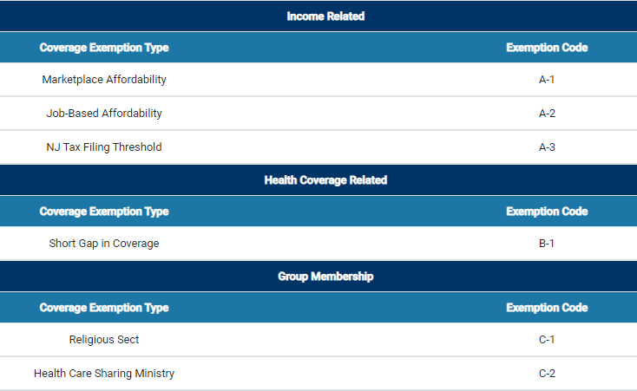
Possible Exemptions from NJ SRP

Slide 23
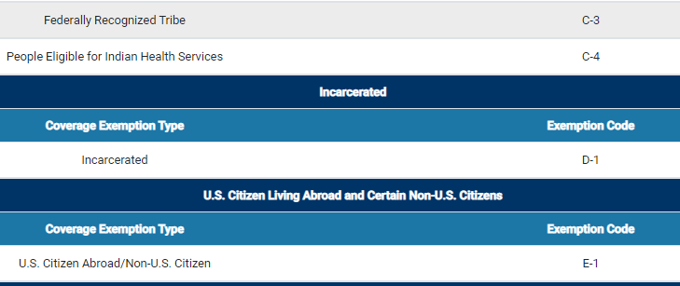
Possible Exemptions from NJ SRP cont’d

Slide 24
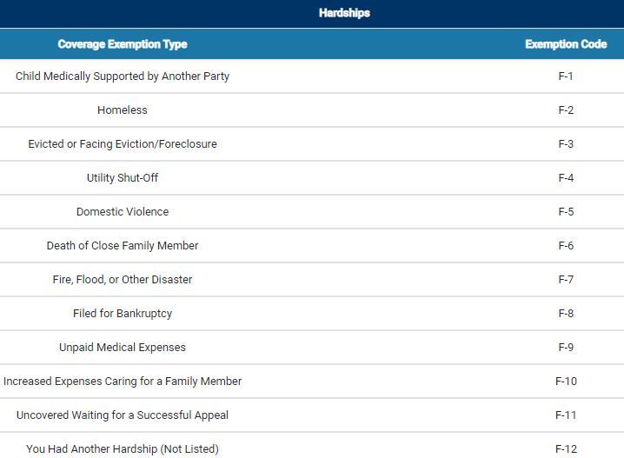
Possible Exemptions from NJ SRP cont’d

Slide 25
NJ Clarification on Exempt Interest Dividends from Mutual Funds
NJ Outreach recently clarified NJ treatment of exempt interest dividends
Tax exempt on Federal return
Taxability varies for NJ, depending on bonds held by fund (look at statement detail pages)
Interest attributable to Federal obligations (including P.R., territories, etc.) always tax exempt
Interest attributable to other states except NJ always taxable
Interest attributable to NJ bonds only tax exempt if fund is “NJ Qualified Investment Fund” (usually has NJ in name of fund)
Interest on NJ bonds held individually by taxpayer (not in a mutual fund) always tax exempt

Slide 26
Scope Changes
Scope Manual is now in NTTC version of 4012 as well as in AARP Volunteer Portal library
Do not rely on IRS versions of 4012 or 4491; TaxAide has additional permissions
1099-INT* Boxes 10-13 and 1099-OID Boxes 5 & 10 are now in scope
Boxes regarding bond premiums and market discounts
If amount in Box 11 (Bond Premium), TSO automatically subtracts from Box 1 taxable interest
If amount in Box 13 (Bond Premium on Tax-Exempt Bond), subtract it from amount in Box 8 (Tax-Exempt Interest) and enter result in Box 8 (see 4012 D-9)
*NJ does not require entry of payer EIN and address on 1099-INT screen

Slide 27
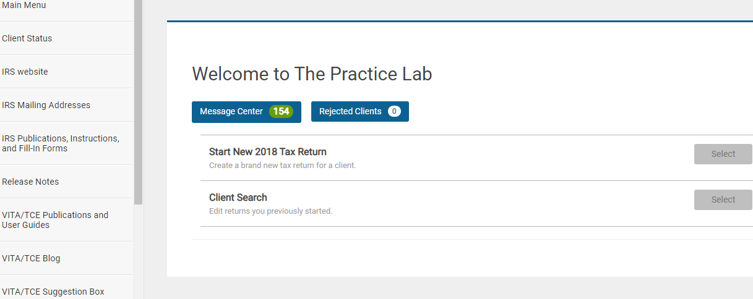
TaxSlayer Changes (cont’d)
Through VITA/TCE Blog (in left-hand column of Practice Lab)
Release Notes in TaxSlayer show enhancements/fixes since December, 2018
Subset report shows enhancements only since May, 2019
Federal and State return types in E-file section will be in same order

